Slide 1
CSE411: 2D- Viewing and Clipping Cohen Sutherland Line Clipping Algorithm
Mahimul Islam Nadim
Lecturer
Department Of CSE
Daffodil International University

Slide 2
2D- Viewing and Clipping

Slide 3
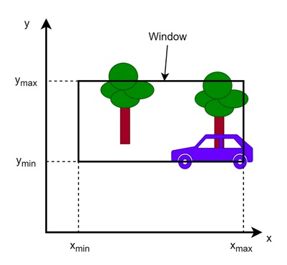
Viewing and Clipping
World coordinate system represents the entire virtual space in a computer graphics application. This space could be a game world, a city layout, or any other virtual environment.
Window − We do not always want to display the entire world at once. Instead, we select a portion of the world for display, which is called the window.
The window defines what part of the world will be visible on the screen.

Slide 4
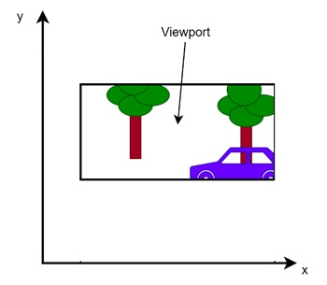
Viewing and Clipping
Viewport − Once the window is selected, we need to display it on the screen.
The area on the screen where this window is displayed is called the viewport. The viewport is the part of the display device (like our monitor or a TV) where the selected window is shown.

Slide 5
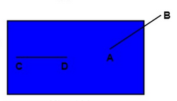
LINE CLIPPING:
The line clipping is a process in which we can cut the part of the line, which lies outside the view window.
Only those lines are visible, which lie inside the view window.

Slide 6
LINE CLIPPING ALGORITHMS:
Line clipping performed by using the line clipping algorithms. The line clipping algorithms are:
Cohen Sutherland Line Clipping Algorithm
Midpoint Subdivision Line Clipping Algorithm
Liang-Barsky Line Clipping Algorithm

Slide 7
Cohen Sutherland Line Clipping Algorithm

Slide 8
COHEN SUTHERLAND LINE CLIPPING ALGORITHM:
This algorithm was named by “Danny Cohen” and “Ivan Sutherland.”
In the algorithm, first of all, it is detected whether line lies inside the screen or it is outside the screen.
All lines come under any one of the following categories (Types of Lines) :
Visible
Not Visible
Clipping Case

Slide 9
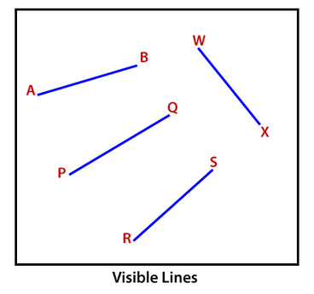
VISIBLE LINE:
The line lying inside the view pane, is a visible line.
Both endpoints of the line lies within the window.

Slide 10
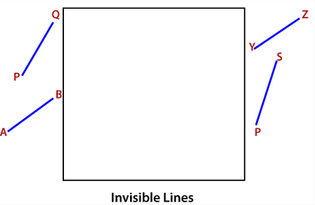
NOT VISIBLE LINE:
The line lying outside the view pane, is an invisible or not visible line.

Slide 11
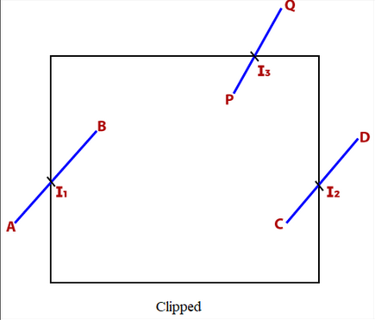
Clipping Candidate:
A line that lies inside or outside the window is called clipped line/Clipping Candidate.”
A point where the line cut the view pane is known as the Intersection point of the line

Slide 12
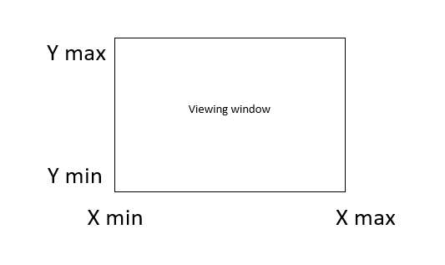
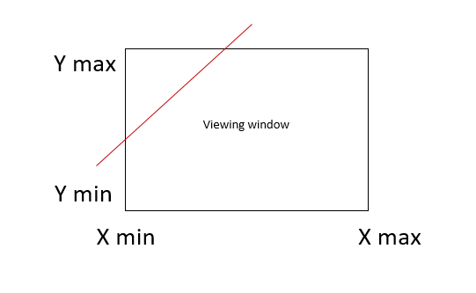
CLIPPED LINE:

Slide 13
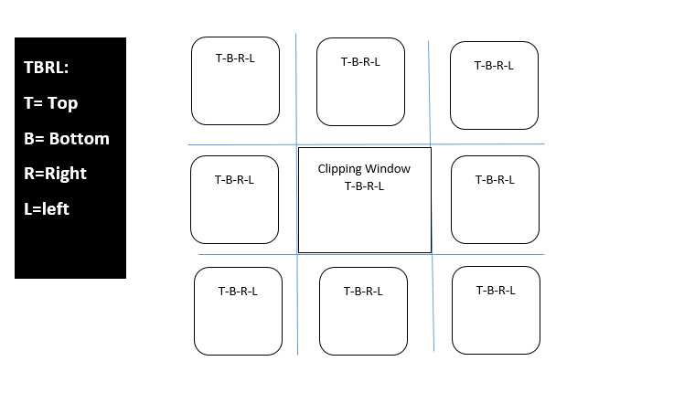
CLIPPED LINE:

Slide 14
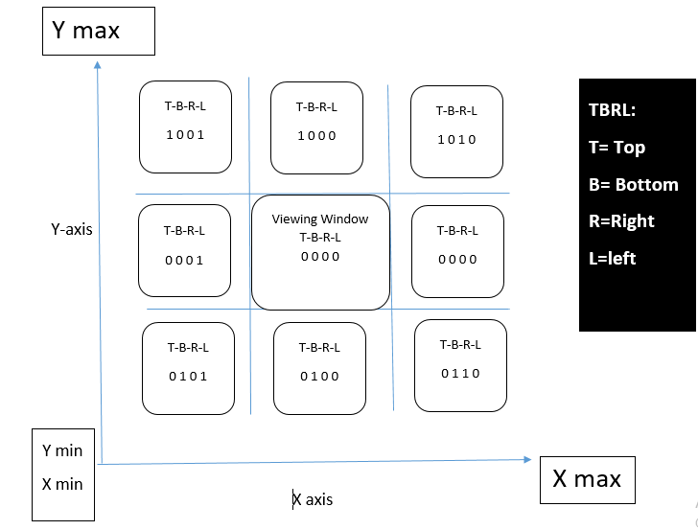
CLIPPED LINE:
.

Slide 15
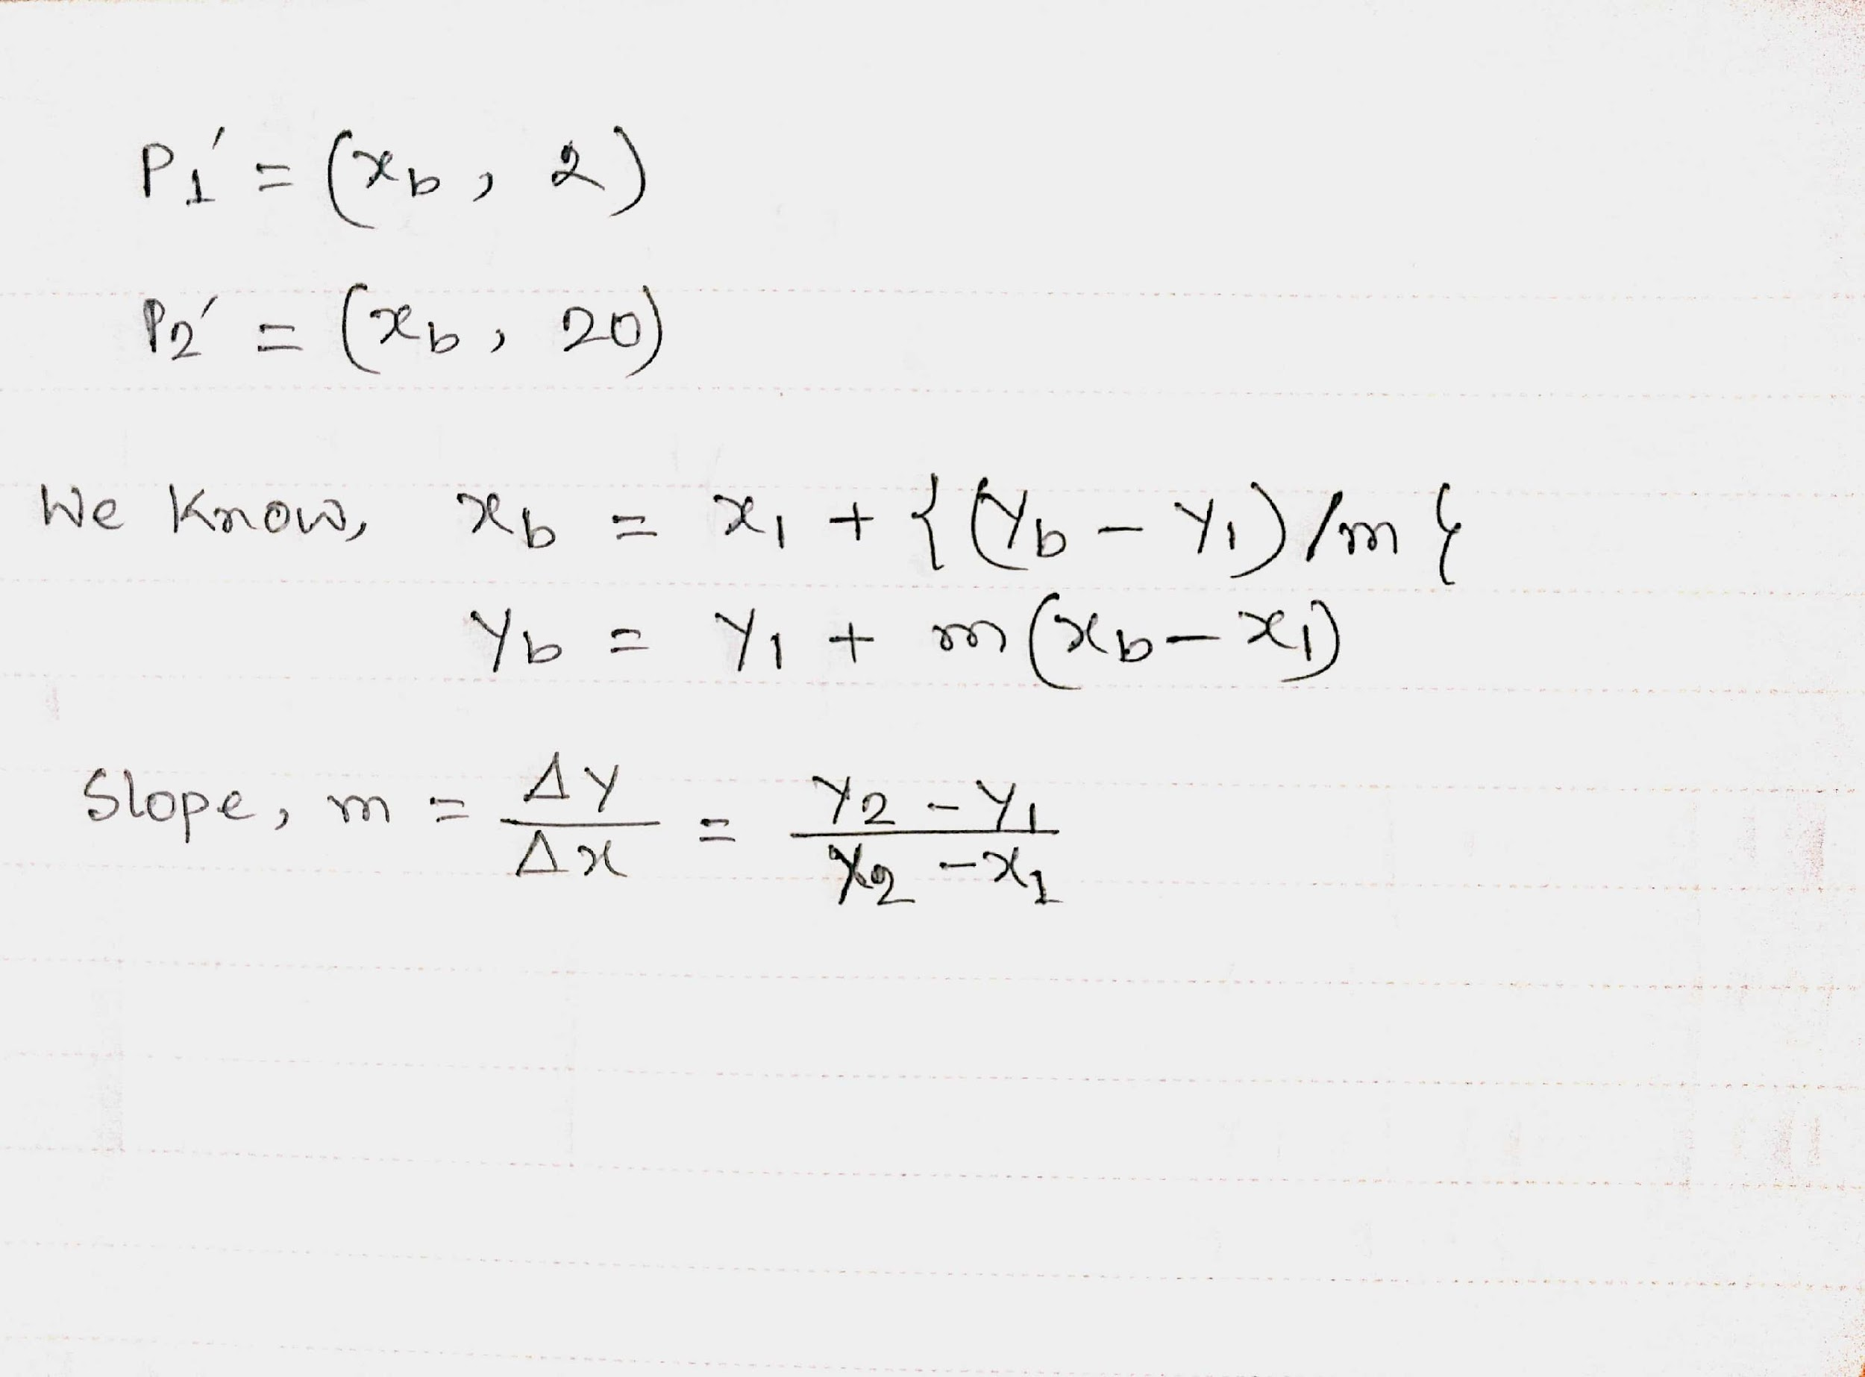
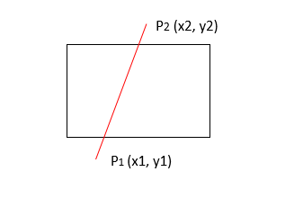
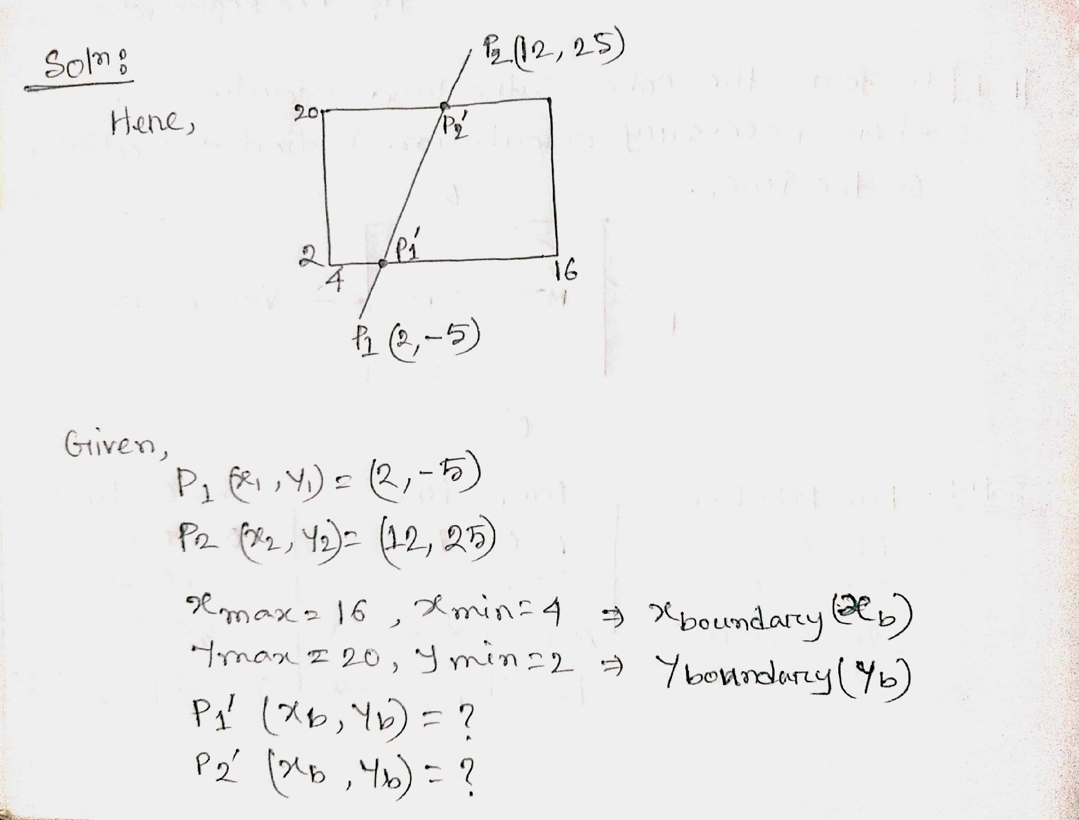
CASES:

Slide 16
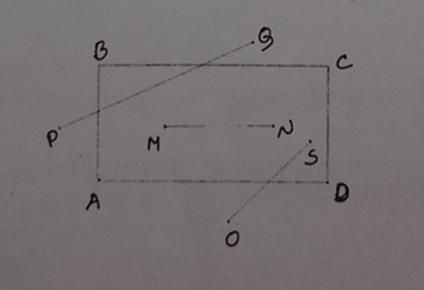
PROBLEM- 1:
P-1: Perform Cohen Sutherland algorithm and show necessary calculation to find the categories of the lines:

Slide 17
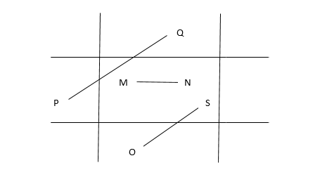
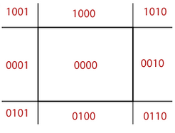
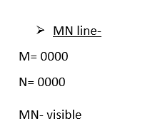
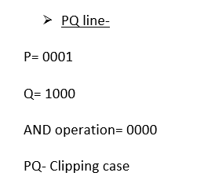
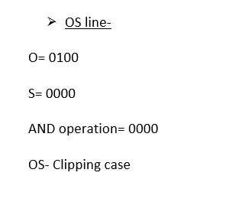
P-1: Perform Cohen Sutherland algorithm and show necessary calculation to find the categories of the lines:
Solution:

Slide 18
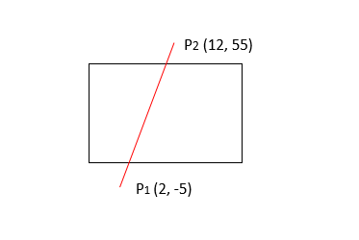
PROBLEM- 2
P- 2: Perform Cohen Sutherland algorithm and show necessary calculation to clip the line- P1P2 and find the coordinate values after clipping. (X max= 16, X min= 4, Y max= 20, Y min= 2)

Slide 19
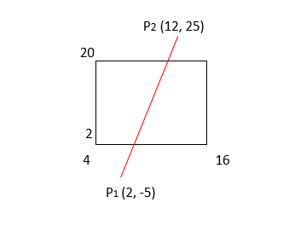
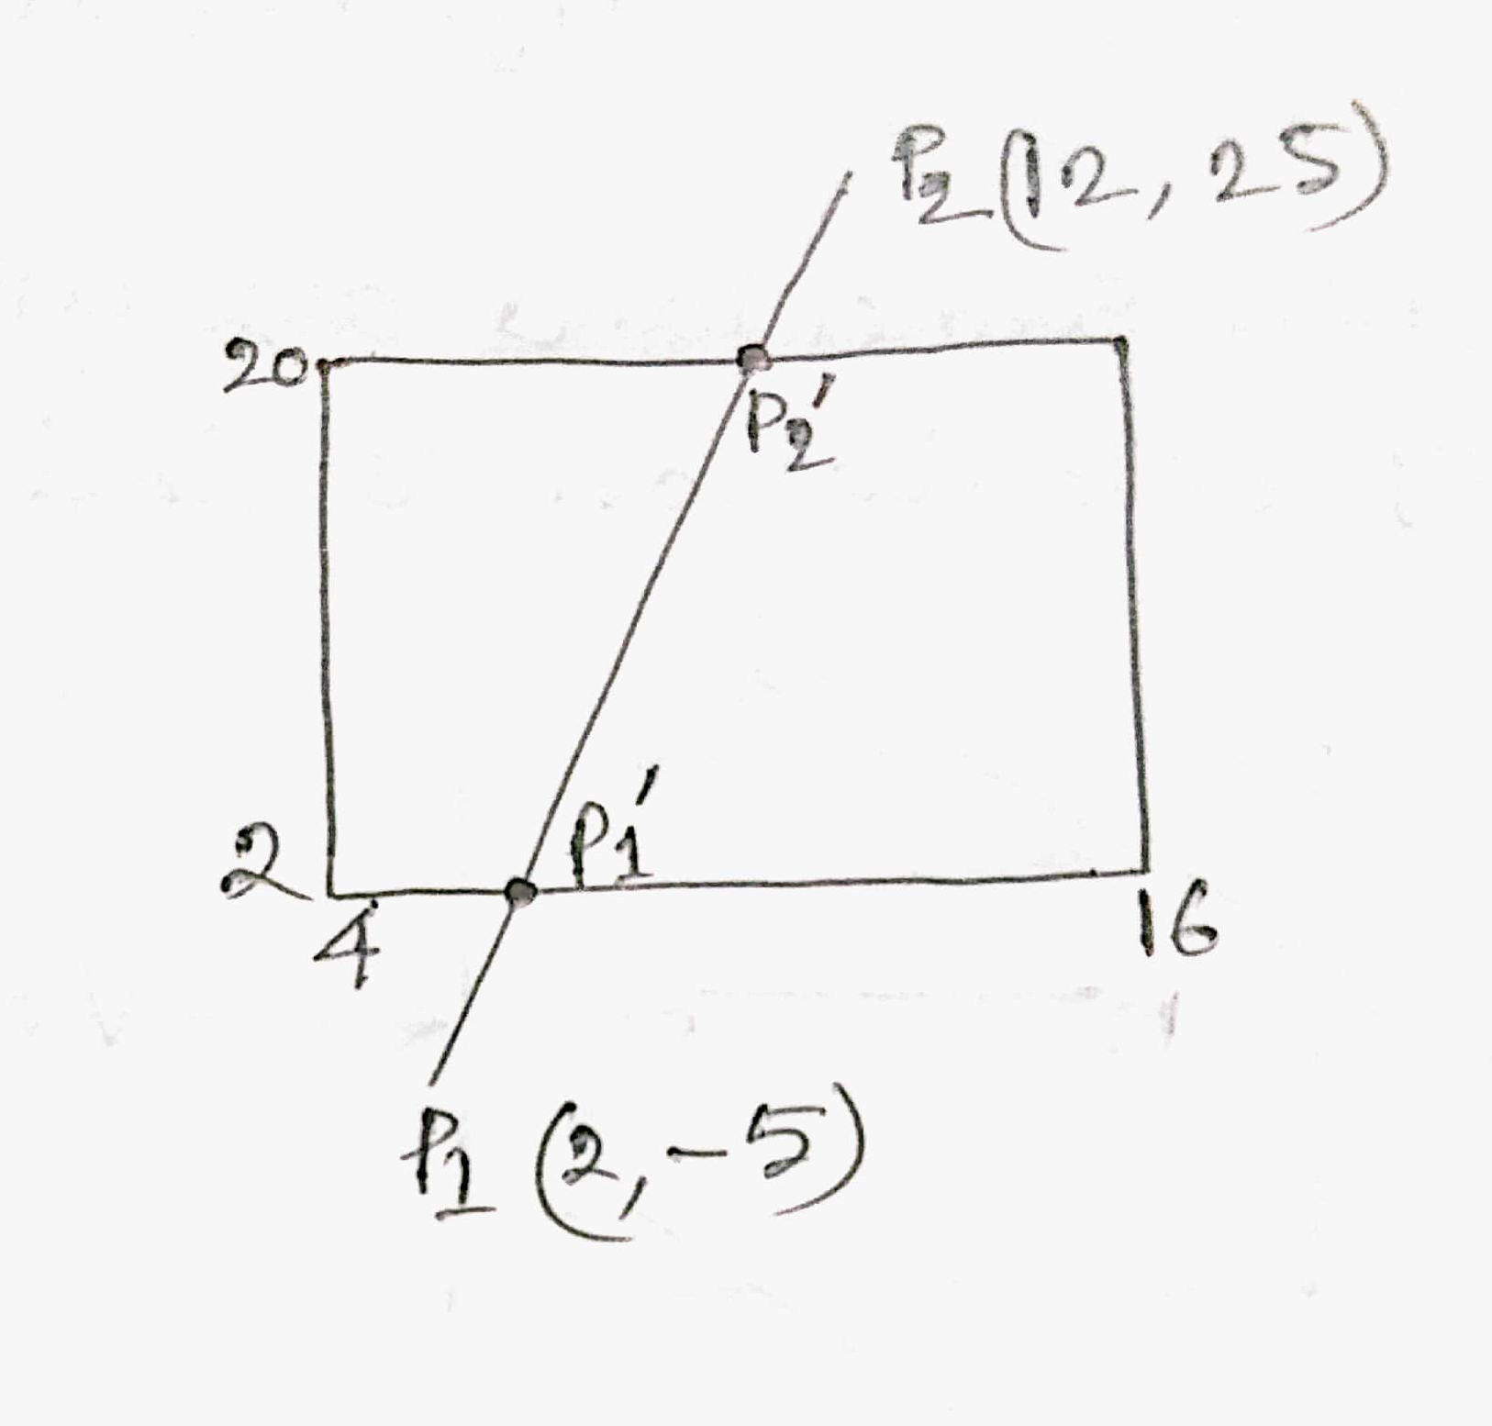
Solution:

Slide 20
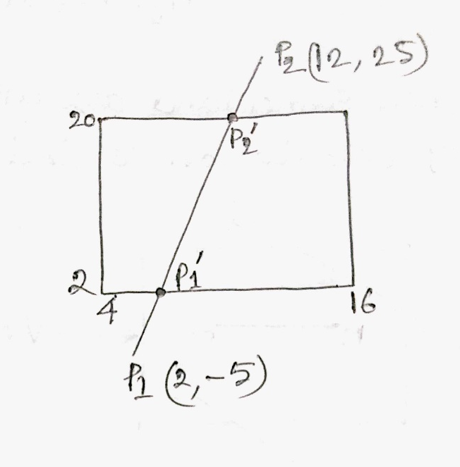
Solution:

Slide 21
Solution:

Slide 22
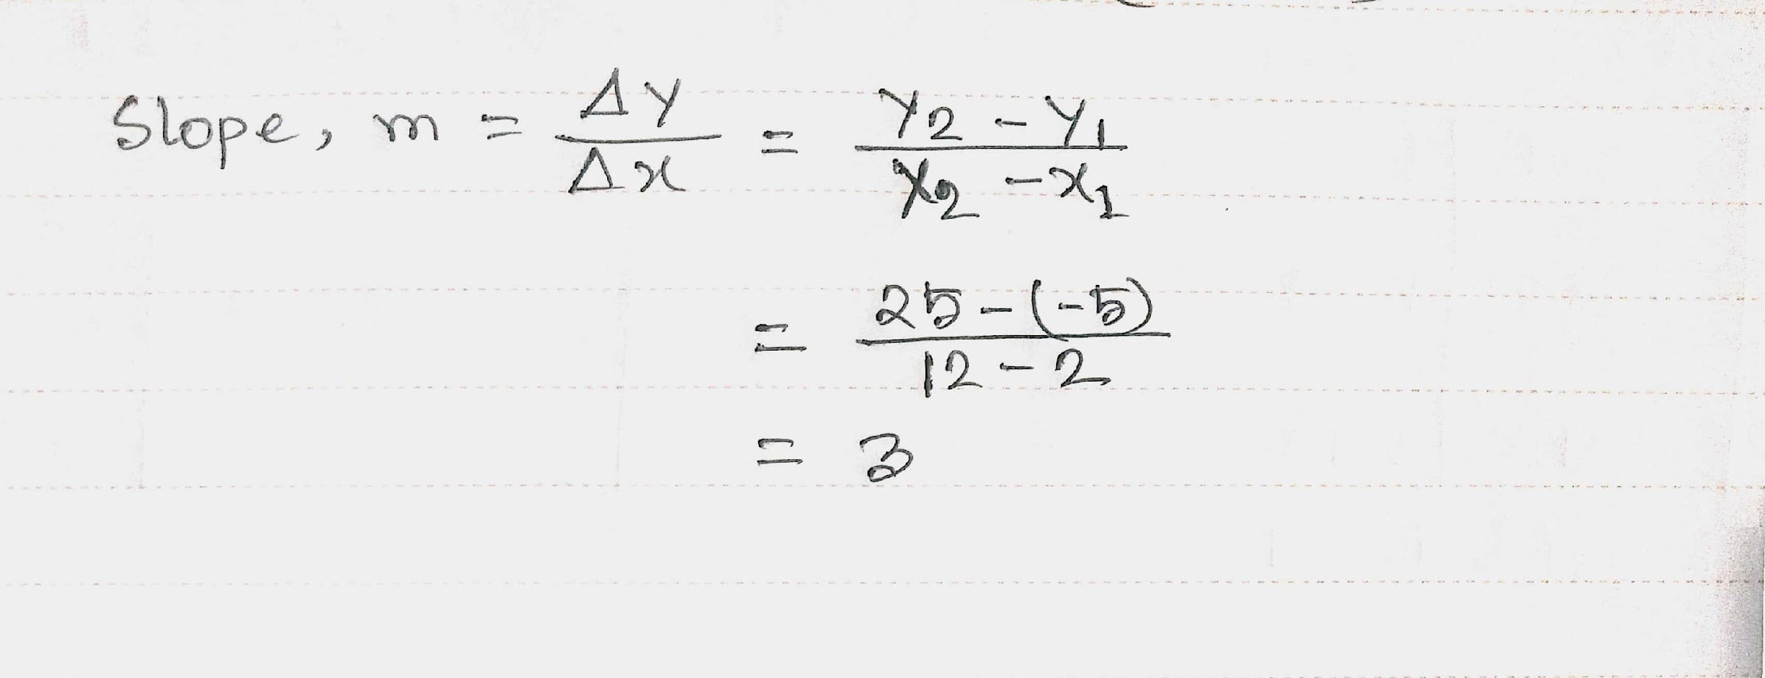

Slide 23
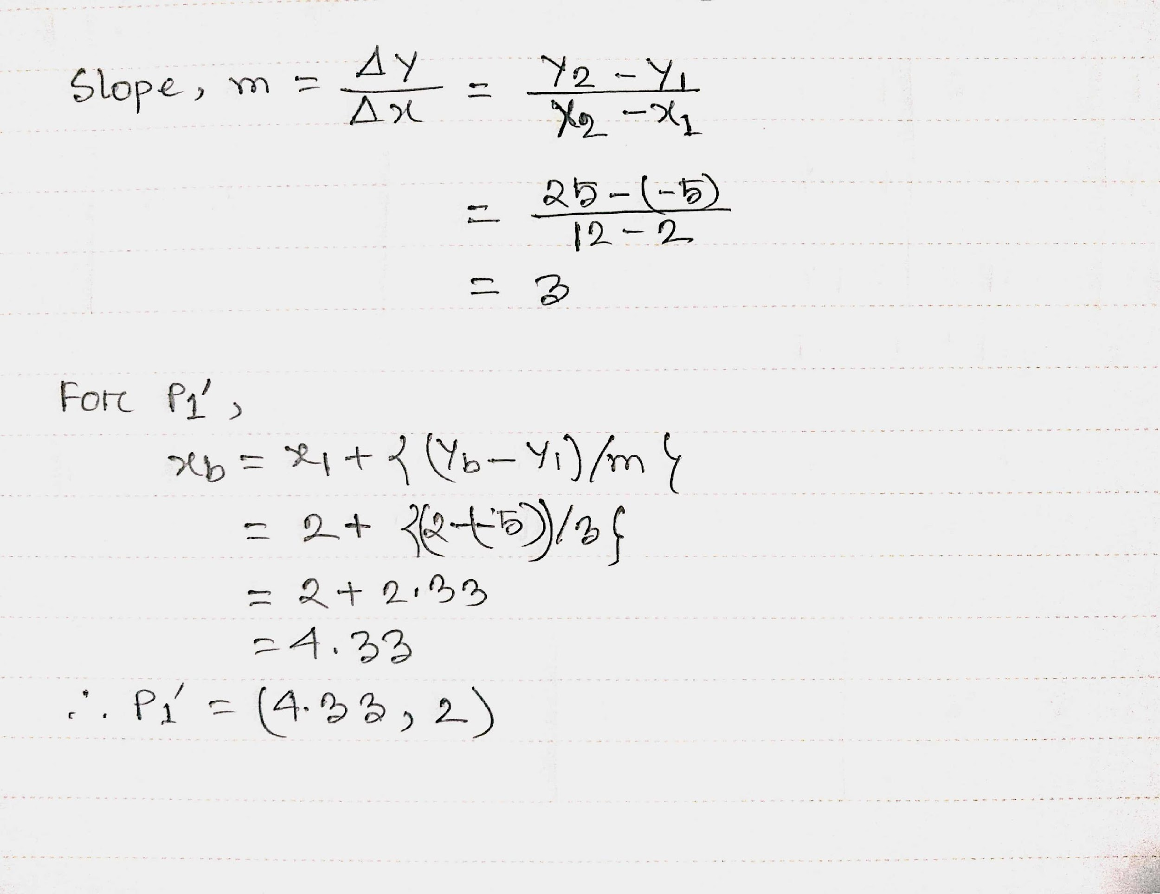

Slide 24
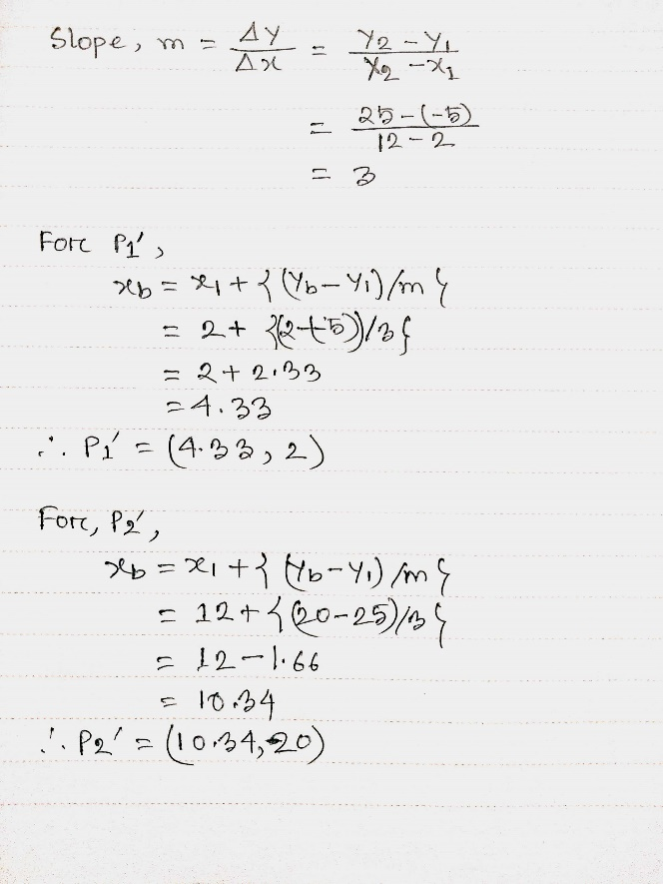

Slide 25
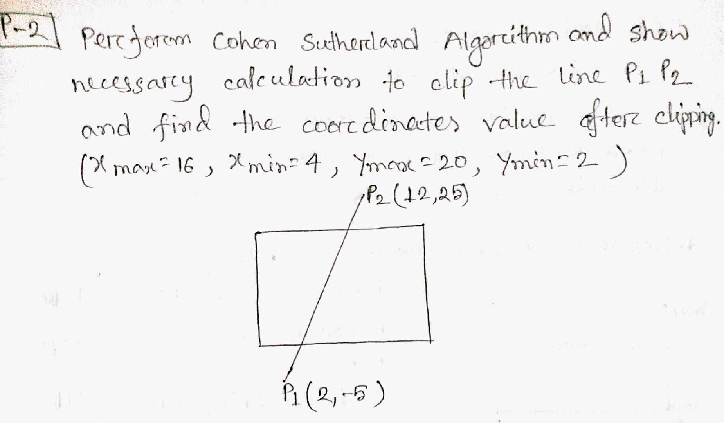
P-2

Slide 26
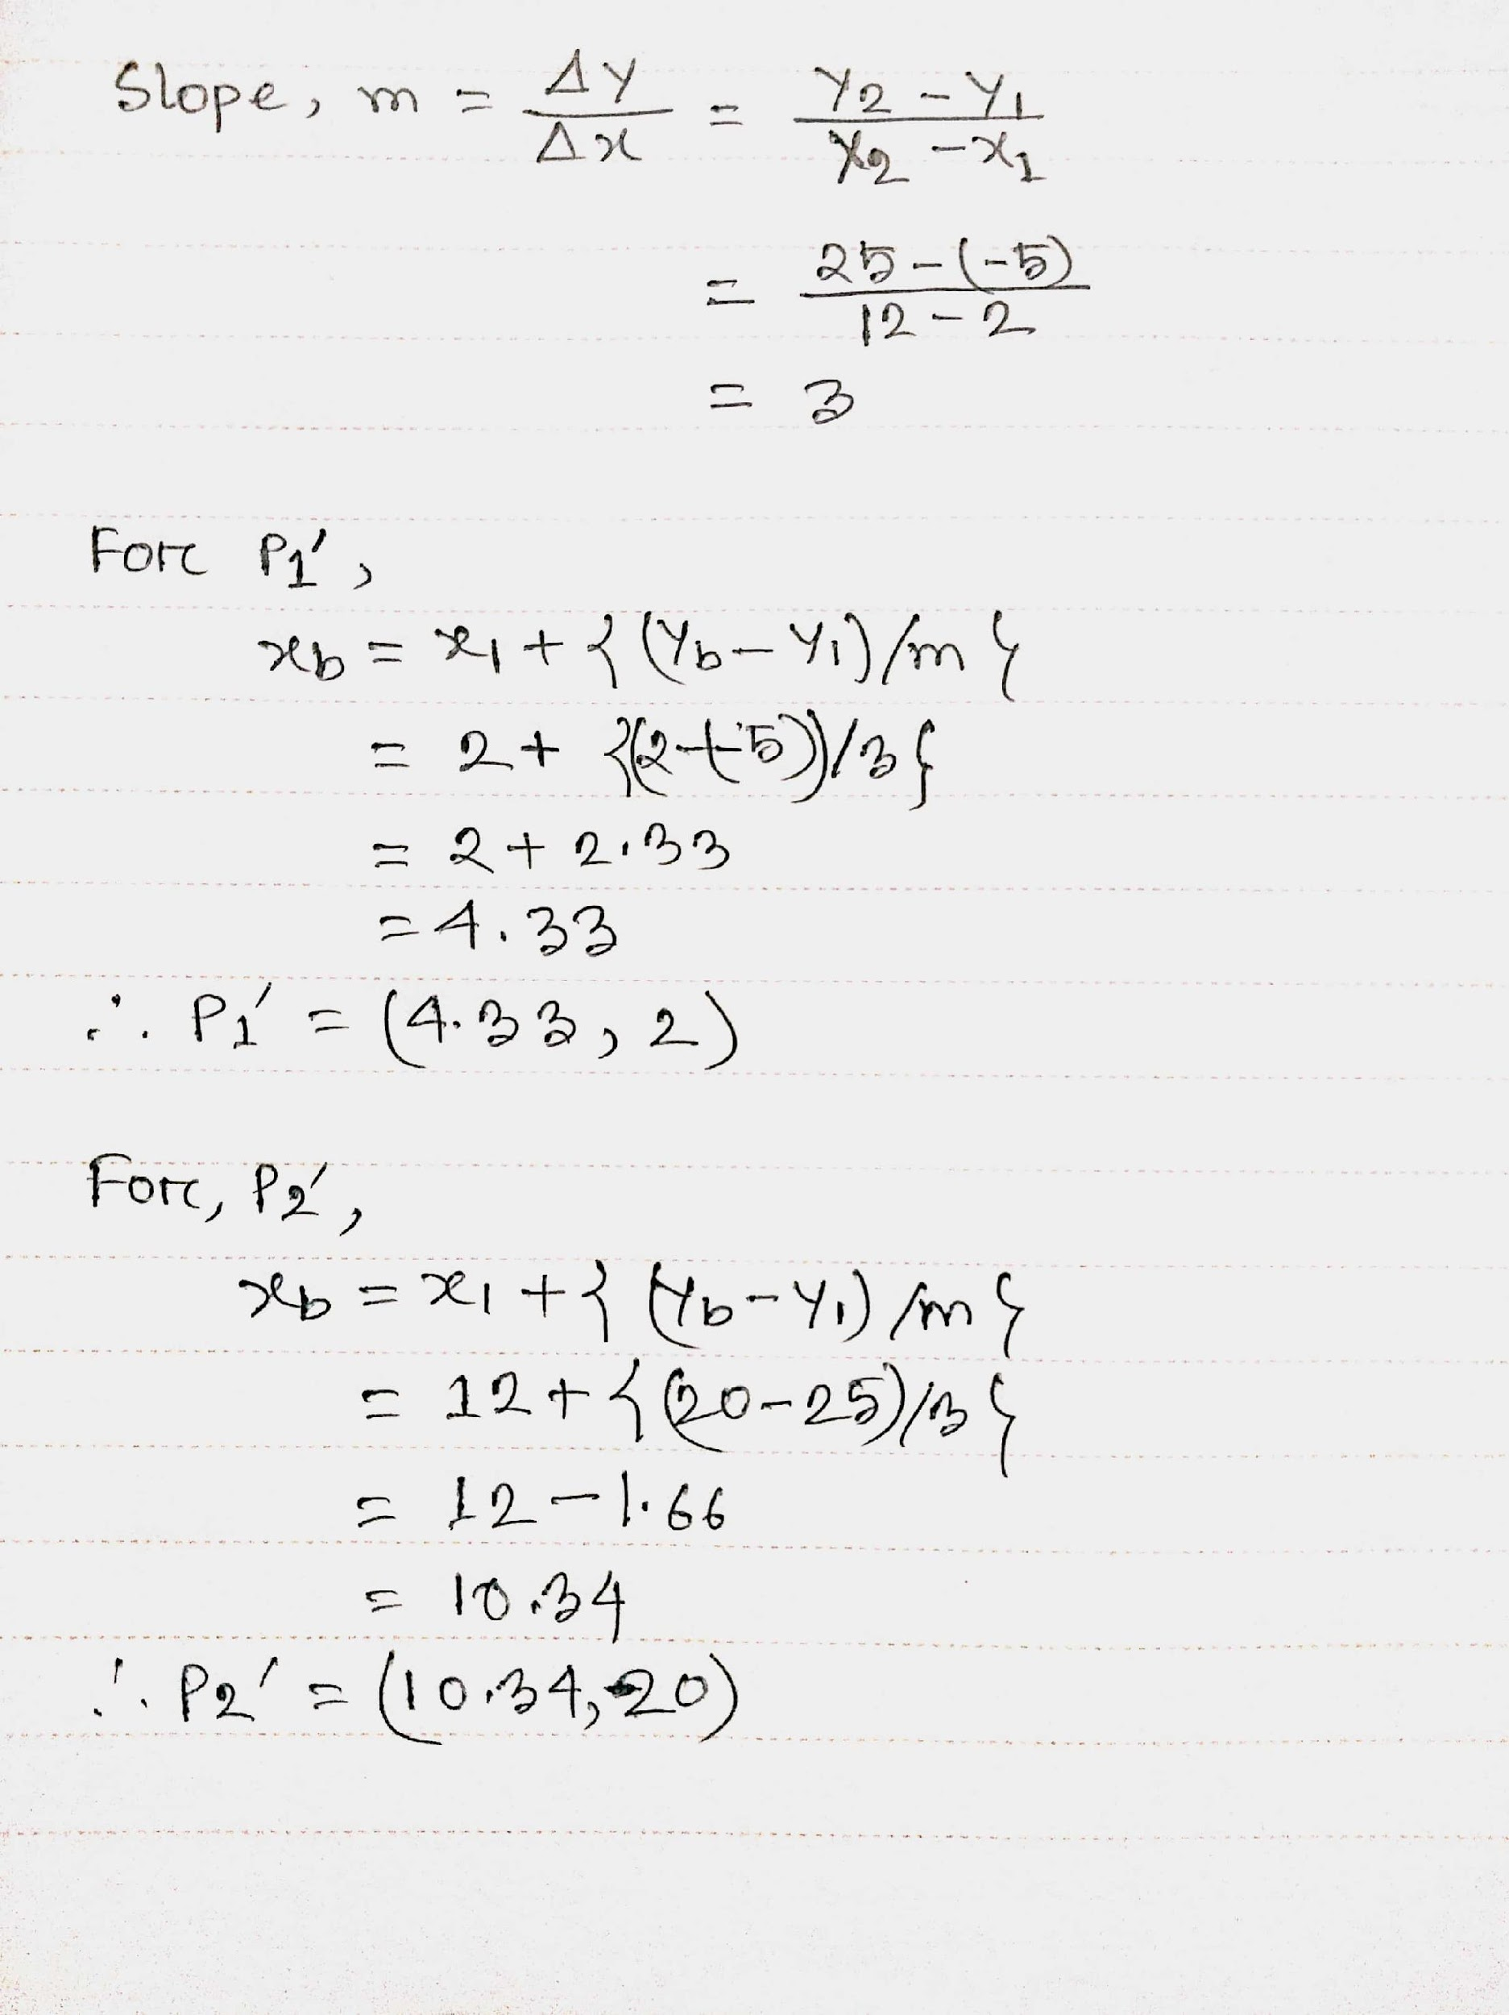
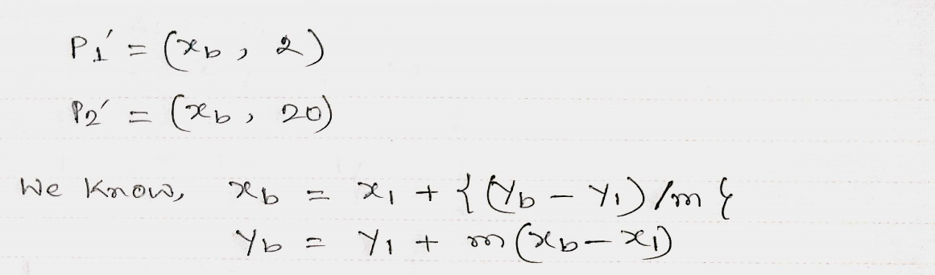
P-2

Slide 27
Thank You…

